Slide 1

Bourhan Barake
October 2022

Slide 2

Outline
Abstract
Introduction
Methodology
Results
Conclusion
Appendix

Slide 3
ABSTRACT
Summary of methodologies
Data Collection through API
Data Collection with Web Scraping
Data Wrangling
Exploratory Data Analysis with SQL
Exploratory Data Analysis with Data Visualization
Interactive Visual Analytics with Folium
Machine Learning Prediction
Summary of all results
Exploratory Data Analysis result
Interactive analytics in screenshots
Predictive Analytics result

Slide 4
Introduction
Project background and context
Space X Falcon9 rocket cost 62 million dollars; other providers cost upward of 165 million dollars each
Much of the savings is because Space X can reuse the first stage.
Determining if the first stage will land, we can determine the cost of a launch.
The goal of the project is to create a machine learning pipeline to predict if the first stage will land successfully.
Problems you want to find answers
What factors determine if the rocket will land successfully?
The interaction amongst various features that determine the success rate of a successful landing.
What operating conditions needs to be in place to ensure a successful landing program.

Slide 5

Section 1

Slide 6
Methodology
Executive Summary
Data collection methodology:
Data was collected using SpaceX API and web scrapping from Wikipedia
Perform data wrangling
One-hot encoding was applied to categorical features
Perform exploratory data analysis (EDA) using visualization and SQL
Perform interactive visual analytics using Folium and Plotly Dash
Perform predictive analysis using classification models
How to build, tune, evaluate classification models

Slide 7
Data Collection
Data collection was done using get request to the SpaceX API.
Decoded the response content as a Json using and turned it into a pandas data frame
Cleaned the data, checked for missing values and fill in missing values where necessary using various techniques.
Performed web scrapping from Wikipedia for Falcon 9 launch records using BeautifulSoup.
The objective was to extract the launch records as HTML table, parse the table and convert it to a pandas data frame for future analysis.

Slide 8
Data Collection – SpaceX API
Requests SpaceX launch data using GET()
Decode response as JSON and turn into Pandas DF using Json_Normalize()
Filtering and cleaning (Including only Falcon9 launches, Dealing with missing values)
We used the get request to the SpaceX API to collect data, clean the requested data and did some basic data wrangling and formatting.
The link to the notebook is: https://github.com/b-barake/Data-Science-Capstone-Project---IBM/blob/2add858071d586e963baa262fbef7d20fd2946c4/Data%20collection/jupyter-labs-spacex-data-collection-api.ipynb

Slide 9
Data Collection - Scraping
Requests SpaceX launch Wiki page using GET()
Create a BeautifulSoup object from the HTML response
Create a data frame by parsing the launch HTML tables
We applied web scrapping to import Falcon 9 launch records using BeautifulSoup
We parsed the table and converted it into a pandas dataframe.
The link to the notebook is: https://github.com/b-barake/Data-Science-Capstone-Project---IBM/blob/2add858071d586e963baa262fbef7d20fd2946c4/Data%20collection/jupyter-labs-webscraping.ipynb

Slide 10

Data Wrangling
We performed exploratory data analysis and determined the training labels.
We calculated the number of launches at each site, and the number and occurrence of each orbits
We created landing outcome label from outcome column and exported the results to csv.
The link to the notebook is https://github.com/b-barake/Data-Science-Capstone-Project---IBM/blob/2add858071d586e963baa262fbef7d20fd2946c4/labs-jupyter-spacex-Data%20wrangling.ipynb

Slide 11
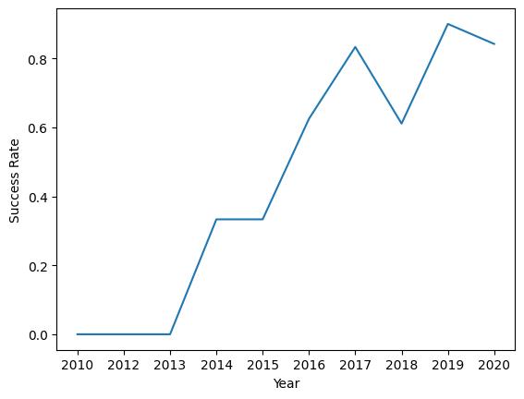
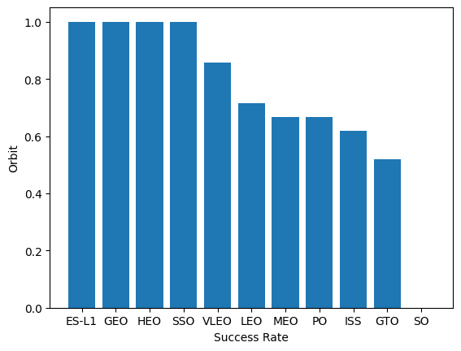
EDA with Data Visualization
Explored the data by visualizing the relationship between flight number and launch Site, payload and launch site, success rate of each orbit type, flight number and orbit type, the launch success yearly trend.
The link to the notebook https://github.com/b-barake/Data-Science-Capstone-Project---IBM/blob/2add858071d586e963baa262fbef7d20fd2946c4/jupyter-labs-eda-dataviz.ipynb

Slide 12
EDA with SQL
We applied EDA with SQLite to get insight from the data. We wrote queries to find out for instance:
The names of unique launch sites in the space mission.
The total payload mass carried by boosters launched by NASA (CRS)
The average payload mass carried by booster version F9 v1.1
The total number of successful and failure mission outcomes
The failed landing outcomes in drone ship, their booster version and launch site names.
The link to the notebook is: https://github.com/b-barake/Data-Science-Capstone-Project---IBM/blob/2add858071d586e963baa262fbef7d20fd2946c4/jupyter-labs-eda-sql-edx_sqllite.ipynb

Slide 13
Build an Interactive Map with Folium
We marked all launch sites, and added map objects such as markers, circles, lines to mark the success or failure of launches for each site on the folium map.
We assigned the feature launch outcomes (failure or success) to class 0 and 1 (failure, success).
Using the color-labeled marker clusters, we identified which launch sites have relatively high success rate.
We calculated the distances between a launch site to its proximities. We answered some question for instance:
Are launch sites near railways, highways and coastlines.
Do launch sites keep certain distance away from cities.

Slide 14
Build a Dashboard with Plotly Dash
We built an interactive dashboard with Plotly dash, this dashboard contains:
A Pie Chart that shows the total launches for selected sites
A Scatter plot showing the relationship between Payload Mass and Outcome for different booster versions
The link to the notebook is: https://github.com/b-barake/Data-Science-Capstone-Project---IBM/blob/2add858071d586e963baa262fbef7d20fd2946c4/spacex_dash_app.py

Slide 15
Predictive Analysis (Classification)
Loaded the data using NumPy and Pandas, transformed the data, split our data into training and testing.
Built different machine learning models and tune different hyperparameters using GridSearchCV.
Accuracy was the metric for our model, improved the model using feature engineering and algorithm tuning.
Compared different models to find the most accurate one.
Link to the notebook: https://github.com/b-barake/Data-Science-Capstone-Project---IBM/blob/2add858071d586e963baa262fbef7d20fd2946c4/SpaceX_Machine%20Learning%20Prediction_Part_5.ipynb

Slide 16
Results
Exploratory data analysis results
Interactive analytics demo in screenshots
Predictive analysis results

Slide 17

Section 2

Slide 18
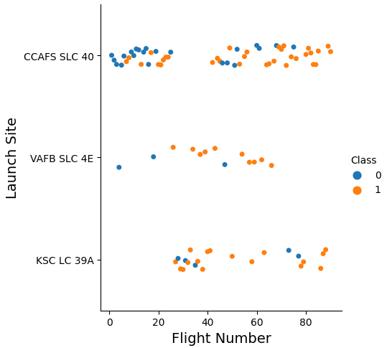
Flight Number vs. Launch Site
Positive correlation between Flight Number and Success in all Launch Sites
The larger the flight amount at a launch site, the greater the success rate at a launch site.
Site KSC was not used for the first 20 flights
Site VAFB is not used since Flight 70
CCAFS is the most used site

Slide 19
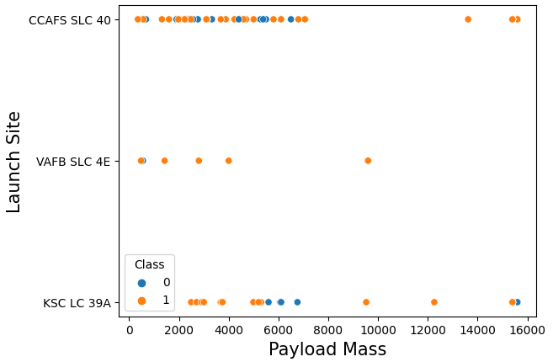
Payload vs. Launch Site
The greater the Payload the more likely it will successfully land.
Site VAFB does not have any launches for heavy payload mass (greater than 10,000 kg)

Slide 20
Success Rate vs. Orbit Type
ES-L1, GEO, HEO, SSO and VLEO had the most success rate.
SO did not have a single successful launch.
ES-L1, HEO, GEO and SO stats are deceiving with only one launch

Slide 21
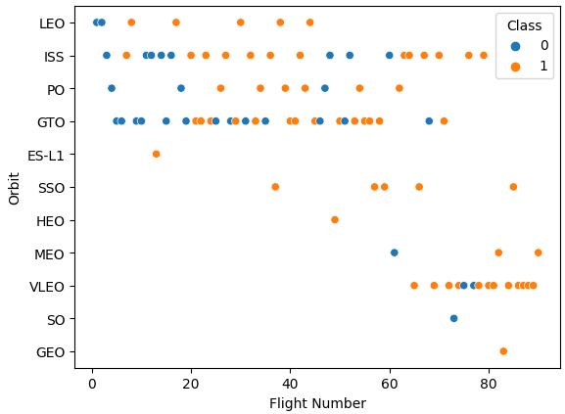
Flight Number vs. Orbit Type
While viewing this chart along with the one in the previous slide, we can gather important insight
ES-L1, HEO, GEO and SO stats are deceiving with only one launch
ISS, GTO and VLEO are the most used sites

Slide 22
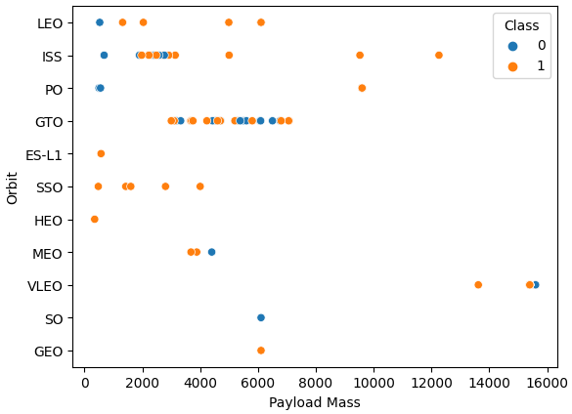
Payload vs. Orbit Type
ISS and VLEO are the only orbits used for heavy Payloads (more than 10,000 kg)
Most Launches are in the 2000 – 8000 kg range for Payload mass

Slide 23
Launch Success Yearly Trend
Until 2013 there were no successful landings for the first stage.
Positive trend since in the 2013-2020 period for success rate.

Slide 24
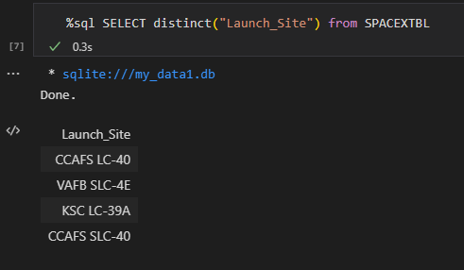
All Launch Site Names
To find the names of the unique launch sites we use DISTINCT.

Slide 25
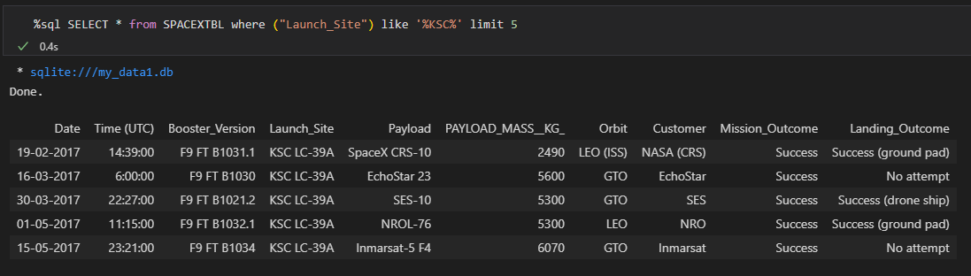
Launch Site Names Begin with 'KSC'
To limit the search for launch sites to begin with KSC we used the query ‘like’
Limit 5 is used to show only the first 5 records

Slide 26
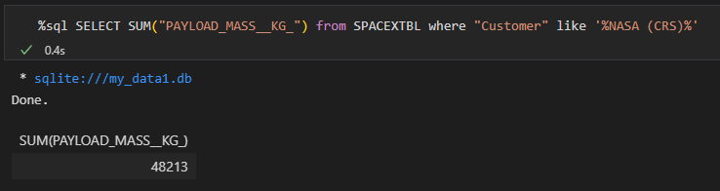
Total Payload Mass
Similar to the previous query ‘like’ is used to find boosters launched by NASA
The function SUM is used to find the total Payload

Slide 27
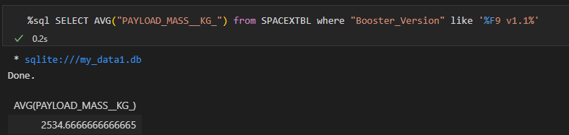
Average Payload Mass by F9 v1.1
Exact same logic as the previous query, but instead the function SUM we use AVG to find the average Payload

Slide 28
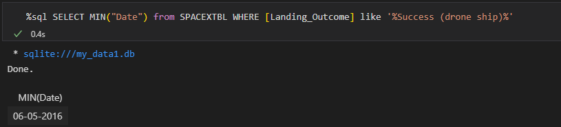
First Successful Ground Landing Date
Since the data type of the column Date is date, we can use the function min to extract the first date that had a successful landing

Slide 29
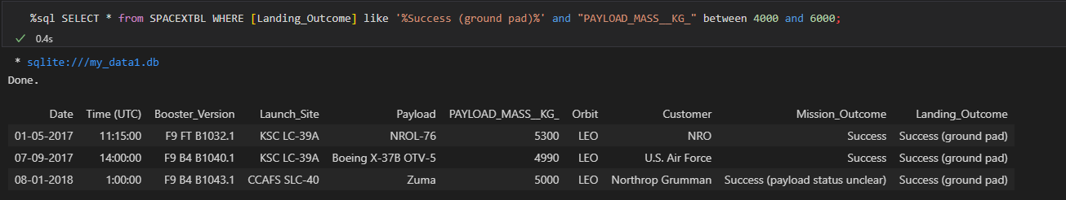
Successful Drone Ship Landing with Payload between 4000 and 6000
To query results between two values, we use the query between x and y

Slide 30
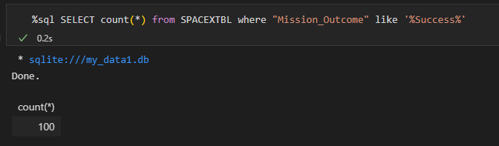
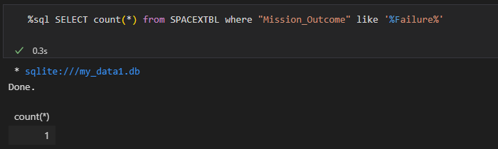
Total Number of Successful and Failure Mission Outcomes
The column Mission Outcome is used to check whether the mission failed or not.
We used the ‘where’ to specify which column we are searching and ‘like’ to specify which outcome we are searching for.

Slide 31
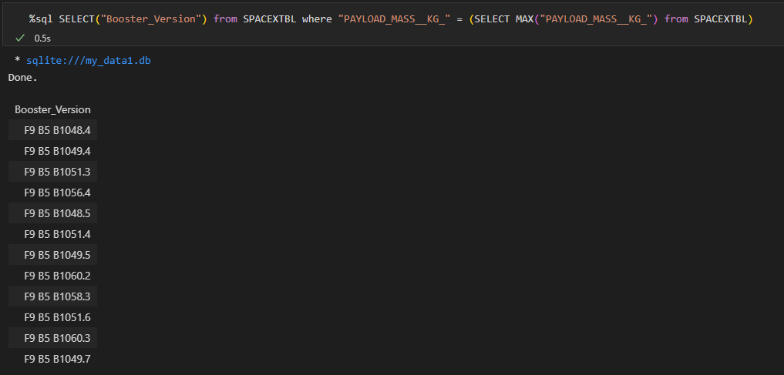
Boosters Carried Maximum Payload
We determined the booster that have carried the maximum payload using a subquery in the WHERE clause and the MAX() function.

Slide 32
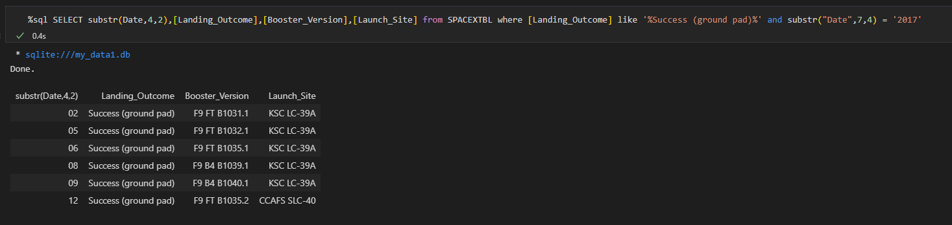
2015 Launch Records
In this query we used the function substr() or sub string to specify which part of the date (or string) we want to search for.
Used the ‘where’ query to find the the successful ground landings and landings in the year 2017

Slide 33
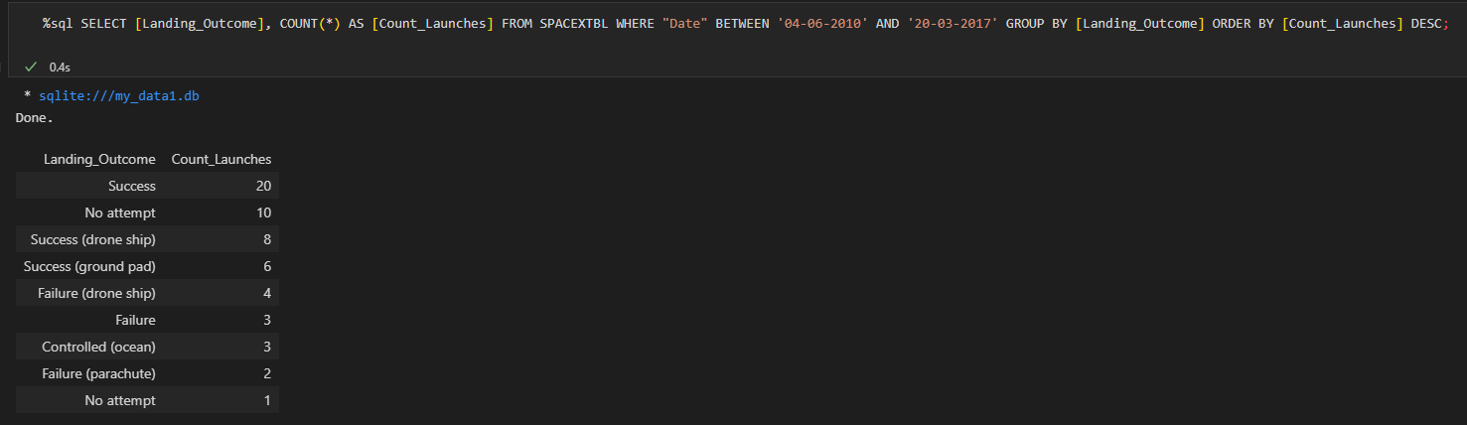
Rank Landing Outcomes Between 2010-06-04 and 2017-03-20
We selected Landing outcomes and the ‘count’ of landing outcomes from the data and used the ‘where’ clause to filter for landing outcomes ‘between’ 2010-06-04 to 2010-03-20.
We applied the ‘group by’ clause to group the landing outcomes and the ‘order by’ clause to order the grouped landing outcome in descending order.

Slide 34

Section 3

Slide 35
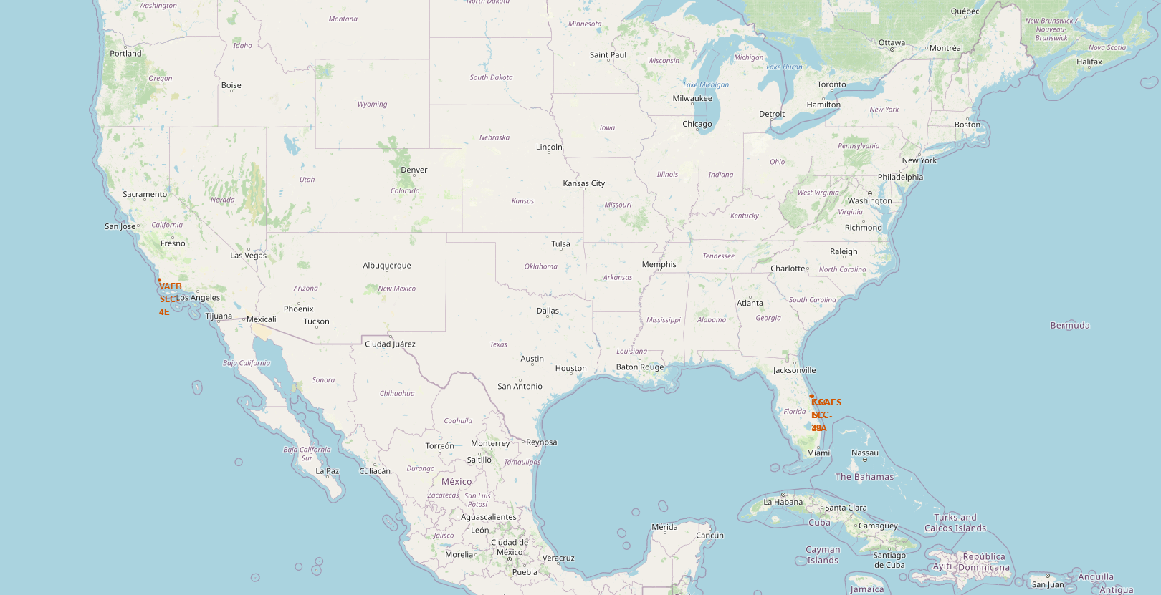
All launch sites global map markers
From the following map, all launch sites from SpaceX are done in US soil, one is in the east coast (Florida) and the other in the west coast (California)

Slide 36
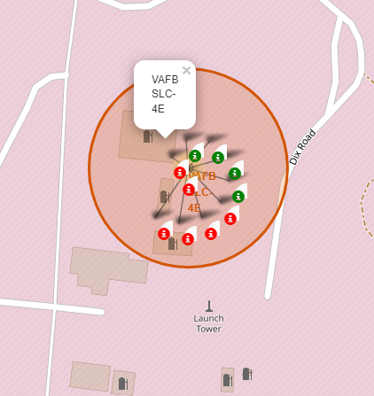
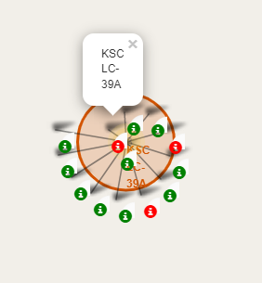
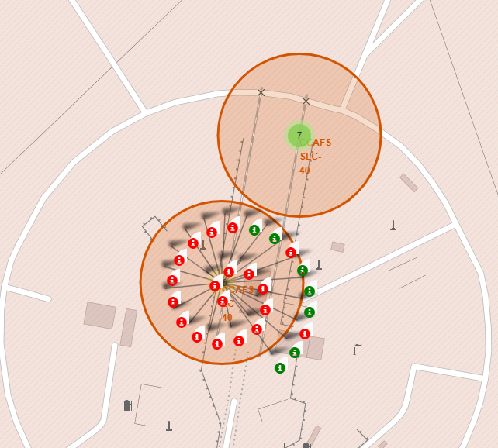
LAUNCH SITES WITH COLOR LABELS

Slide 37
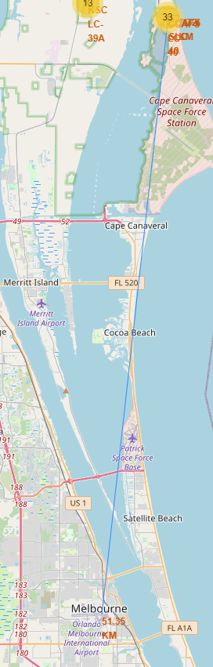
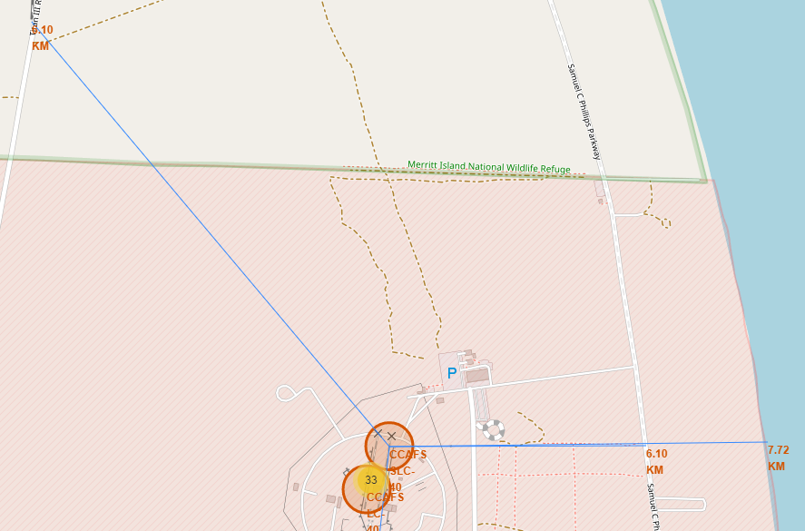
Launch Site distance to landmarks

Slide 38

Section 4

Slide 39
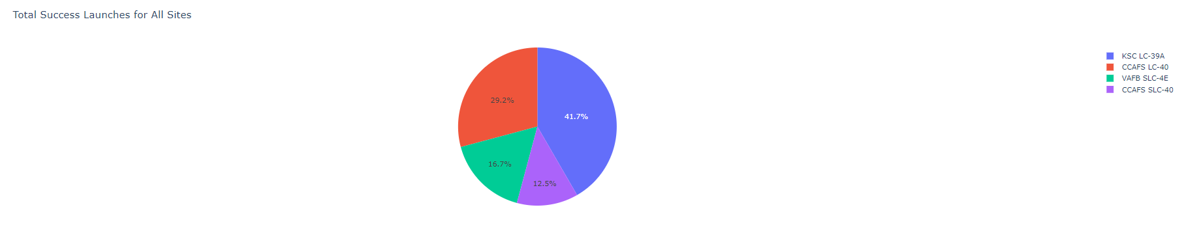
Success rare for all launch sites
From the pie chart below, site KSC had the most successful launches with a value of 41.7%

Slide 40
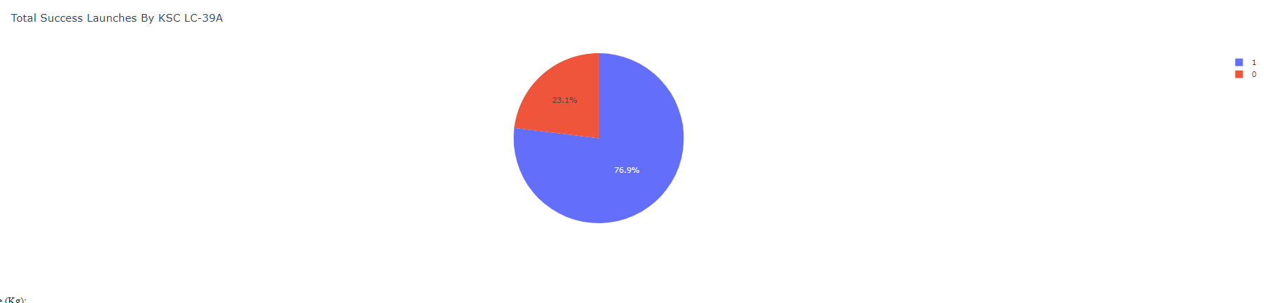
Total Success Launches by KSC LC-39A
KSC had a success rate of 76.9%

Slide 41
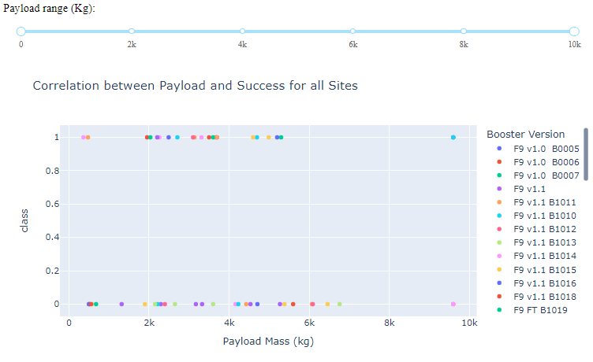
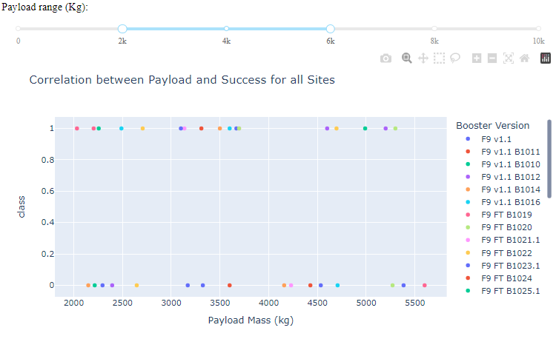
Scatter Plot - Payload vs Success for different Booster Versions
Most Launches happened in the 2000-6000kg range
The

Slide 42

Section 5

Slide 43
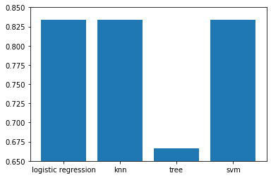
Classification Accuracy
The following bar chart shows the accuracy of 4 different classification models, the decision tree model had the lowest accuracy with about 65%
For log reg, KNN and SVM it is hard to see the difference from the graph, by creating a simple line of code it was found that logistic regression was the most accurate model

Slide 44
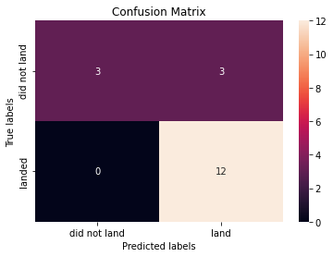
Confusion Matrix
Using a logistic regression model, it was able to correctly predict 100% of the positive landings.
The problem was with the false negatives with an accuracy of 50%

Slide 45
Conclusions
We can conclude that:
The larger the flight amount at a launch site, the greater the success rate at a launch site.
Launch success rate started to increase in 2013 till 2020.
Orbits ES-L1, GEO, HEO, SSO, VLEO had the most success rate.
KSC LC-39A had the most successful launches of any sites.
Logistic Regression is the best machine learning algorithm for this task.

Slide 46


